Slide 1

TITLE:
Mini Project(BIS586) Presentation –(2025-2026)
Under the Guidance of
Prof. or Dr. Guide Name
Designation
Department of ISE
Acharya Institute Of Technology
Batch No:-
Project Team Members:
ABC (1AY19IS0XX)
PQR (1AY19IS0XX)
XYZ (1AY19IS1XX)
IJK (1AY19IS1XX)

Slide 2
Agenda
2
Abstract
Introduction
Problem Statement
Requirement Specification(Hardware & Software)
System Design ( Data Flow Diagram and Flow Charts or Class Diagram or Use Case Diagram or Activity diagram)
7. Implementation (All Modules)
8. Testing
9. Test Cases
10. Results(Snapshots)
11. Future Enhancements
12. Conclusion
13. References

Slide 3
Abstract
AI mock interview is an advanced cloud-based mock interview platform powered by Google’s Gemini API. The system leverages AI to generate domain-specific interview questions, evaluate candidate responses, and deliver instant, personalized feedback. Designed to provide a comprehensive and scalable interview preparation experience, it supports a wide range of technical domains and job roles. Built with Next.js (App Router) on the frontend and a backend with API routes, the platform ensures smooth user interaction, real-time response evaluation, and actionable insights to improve interview performance.
On the backend, Drizzle ORM paired with NeonDB (Postgres) ensures efficient data persistence, while Clerk handles secure user authentication. For premium features, the platform integrates Stripe to manage paid upgrades, allowing users to unlock advanced functionality. With scalability in mind, Docker and Vercel provide seamless deployment, ensuring the platform is both reliable and easy to maintain. SimulateRecruitAI’s mission is to democratize access to effective interview preparation, making it an ideal tool for students, job seekers, and enterprises looking to streamline interview processes.
3

Slide 4
INTRODUCTION
Traditional mock interview systems have significant limitations — they are often resource-intensive, require human involvement, and suffer from inconsistencies in question quality and feedback. In addition, these systems are typically rigid, offering little room for personalization or skill-level adjustments. With the increasing need for scalable, efficient, and accessible interview preparation, AI presents an ideal solution. Artificial intelligence can provide on-demand, personalized practice that adapts to the user's experience level, learning style, and industry focus. It not only automates the interview process but also gives precise feedback tailored to individual responses, ensuring both practice and learning.
The advent of generative AI, like Google’s Gemini API, allows for the creation of a system that overcomes these limitations by providing an automated, intelligent solution. This platform enables users to practice interviews anytime and anywhere, receiving instant, AI-generated feedback, which would be impossible with traditional systems. By doing so, it addresses the growing demand for effective and scalable training tools, catering to a wide audience ranging from students to professionals.

Slide 5
PROBLEM STATEMENT
In the current landscape, learners and professionals preparing for interviews face significant challenges. Traditional interview preparation methods, such as mock interviews with mentors or online courses, are often resource-intensive, costly, and inconsistent. Many learners also struggle to get personalized feedback, which is crucial for improving their performance. Furthermore, current solutions often fail to provide scalability — interviews require scheduling and active participation from instructors or peers, limiting the frequency and depth of practice.
Key Issues:
Lack of Personalization: Many existing tools and platforms offer generic, one-size-fits-all practice questions, failing to adapt to the user's skill level or area of focus. Users often end up practicing questions that may not be relevant to their specific job role or level of expertise.
Inability to Scale: Many candidates may only have access to a limited number of mock interviews before their exam or job application deadline. Once the mock interview is over, they often don’t get the chance to repeat it with varied scenarios or improved practices.

Slide 6
REQUIREMENT SPECIFICATION
Hardware:-
Processor: Intel i5 or higher
RAM: 8 GB+
Storage: 250 GB
Stable broadband internet
Software:-
Frontend: Next.js (React, App Router), TailwindCSS, Radix UI
Backend: Next.js API routes, Node.js
AI: Gemini API (Google)
DB: Neon (Postgres) + Drizzle ORM
Auth: Clerk
Payments: Stripe
DevOps/Deploy: Docker, Vercel
Dev Tools: VS Code, GitHub, Postman
Env vars (sample):
  NEXT_PUBLIC_GEMINI_API_KEY, Clerk keys, Neon DB URL

Slide 7
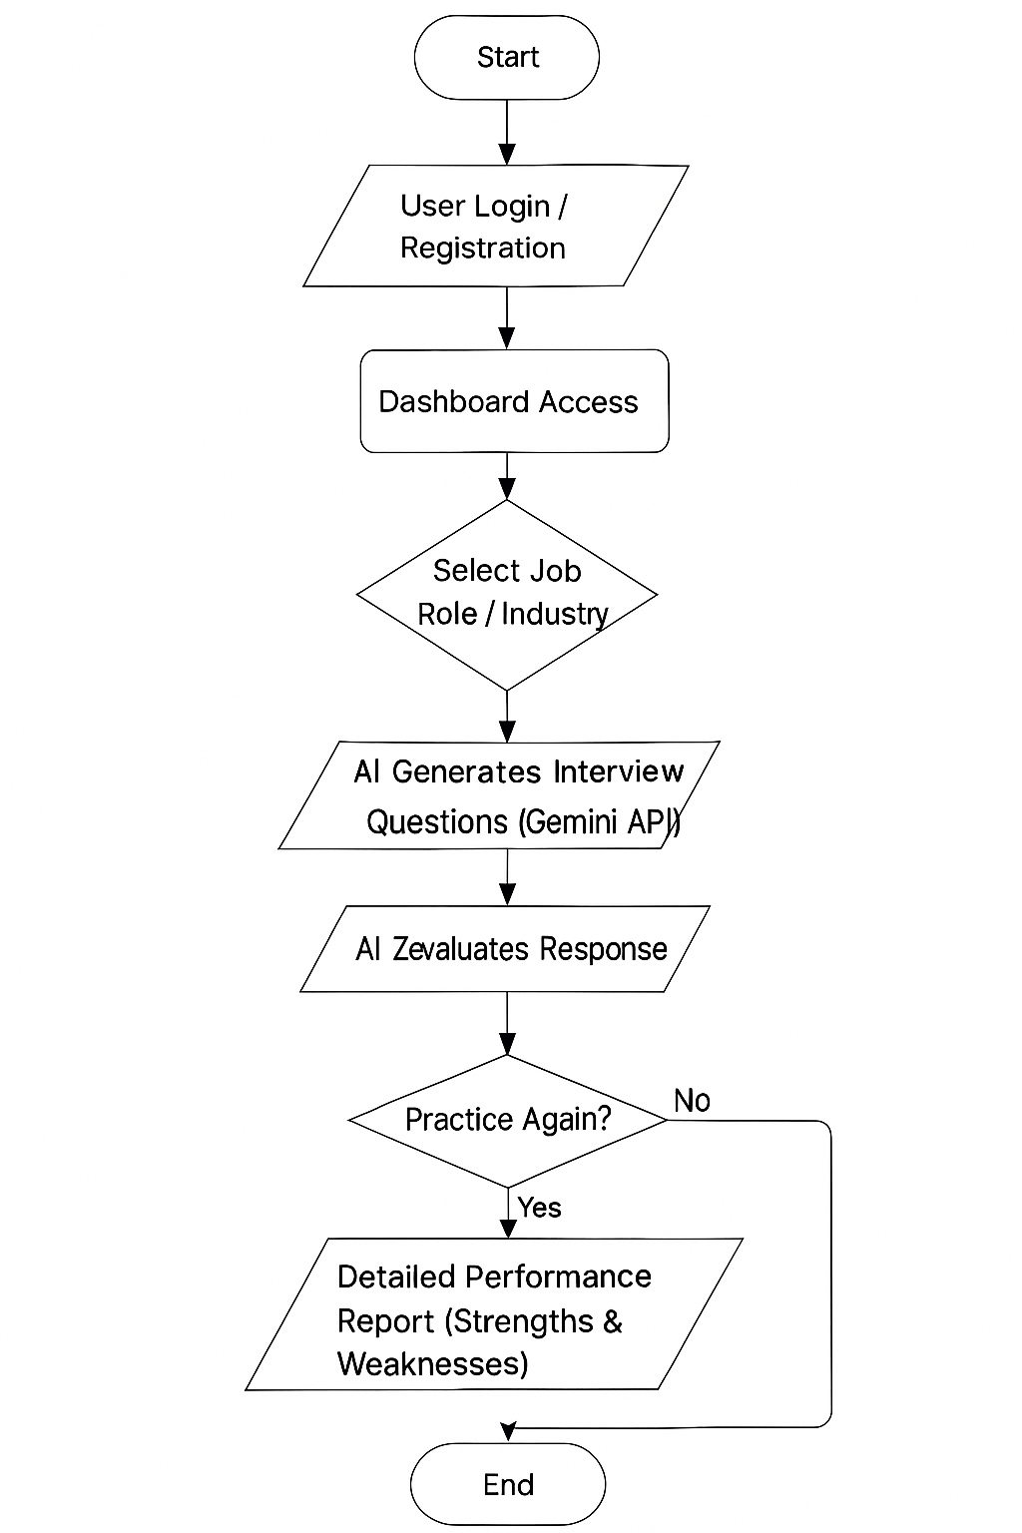
SYSTEM DESIGN
Flow chart Diagram

Slide 8
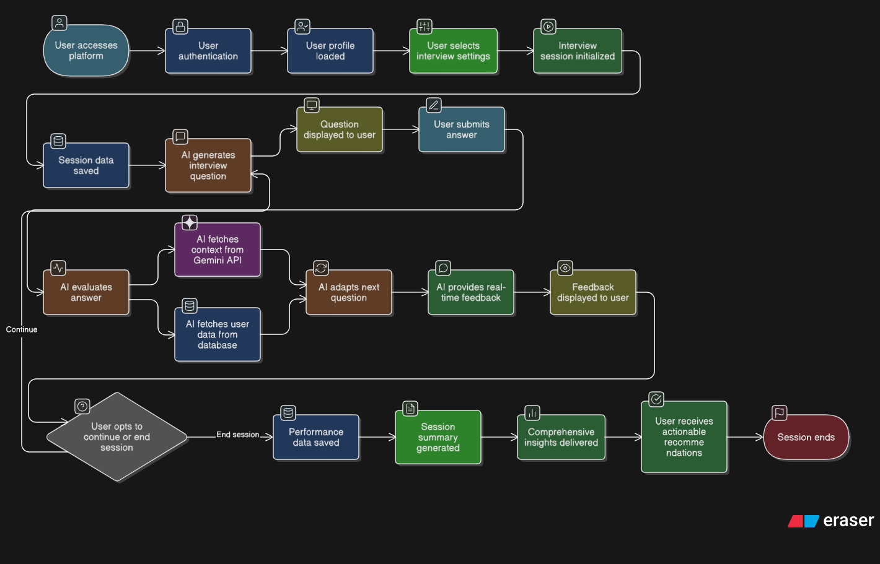
SYSTEM DESIGN
Data Flow diagram

Slide 9
IMPLEMENTATION
1. Authentication Module (Clerk)
  Secure sign-in/sign-up; middleware guarding dashboard/interview routes
.
2. Interview Generation (Gemini)
  Prompt-builds by domain and difficulty; returns JSON-structured question sets.
  Supports custom interviews & PYQ.
3. Persistence Layer (Drizzle + Neon)
  Tables: user, mock_interview, question, user_answer, newsletter
  Typesafe queries & migrations via Drizzle.
4. Dashboard & Analytics
  Progress charts, interview history, per-skill breakdown, retry flow.
5. Payments (Stripe)
  Test checkout & plan gating (upgrade page).
6. Packaging & Deployment
  Dockerfile + compose; deploy on Vercel.

Slide 10
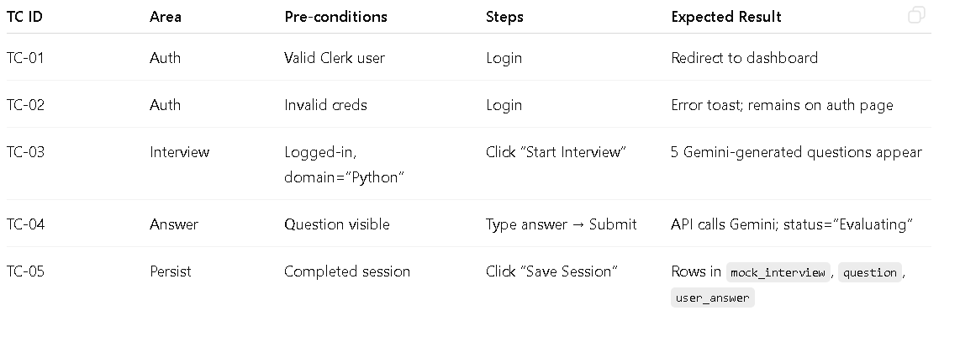
TESTING

Slide 11
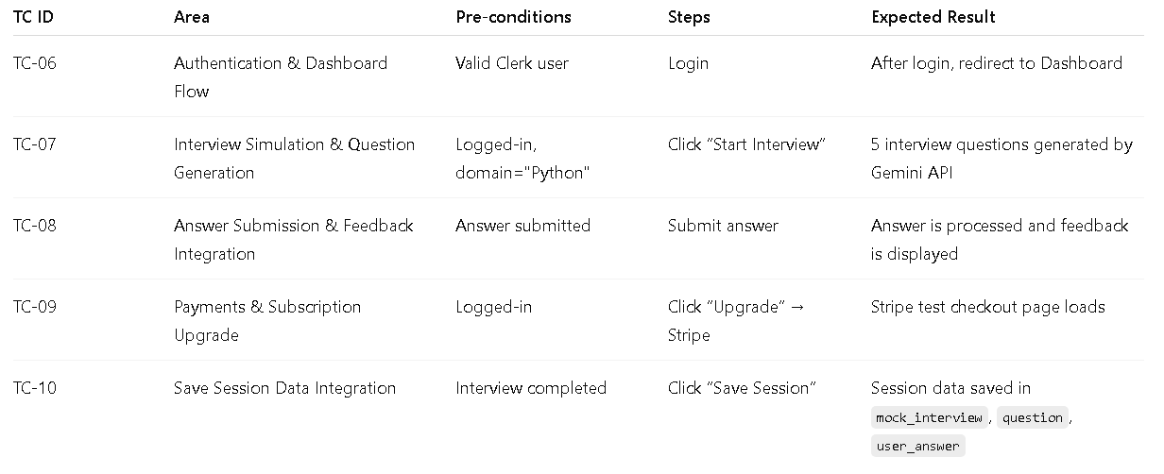
TESTING

Slide 12
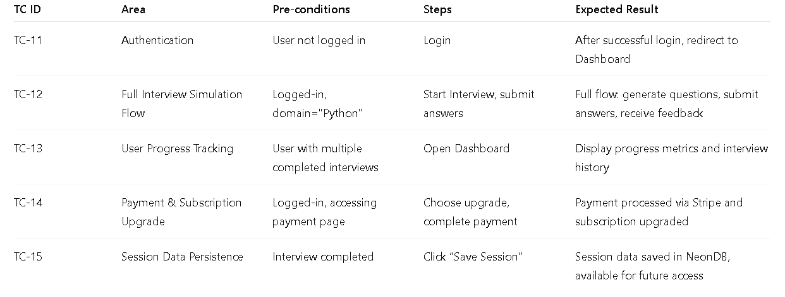
TESTING

Slide 13
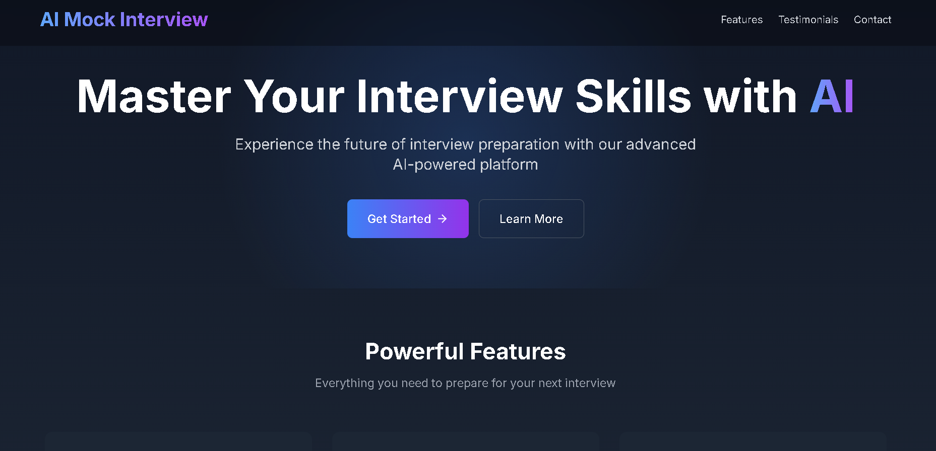
RESULTS

Slide 14
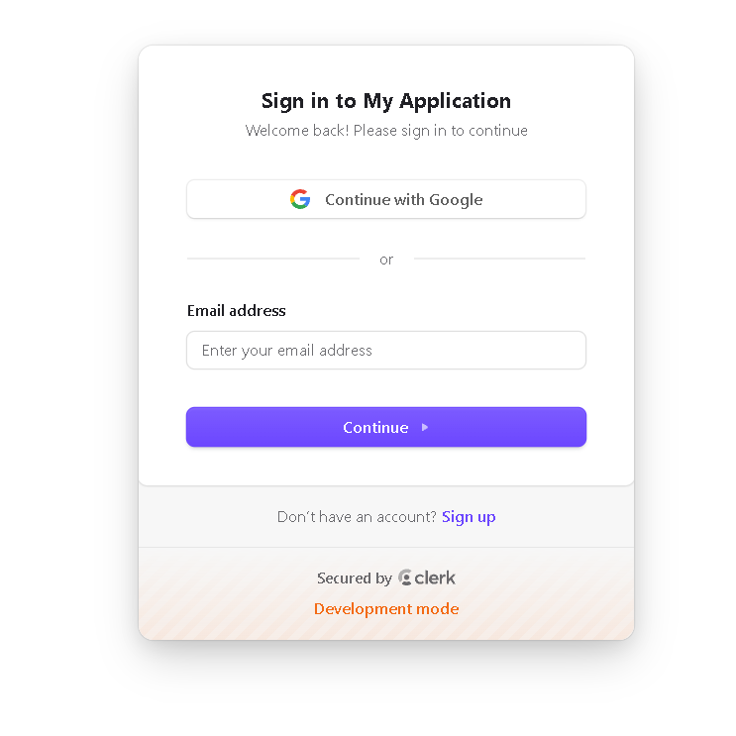
RESULTS

Slide 15
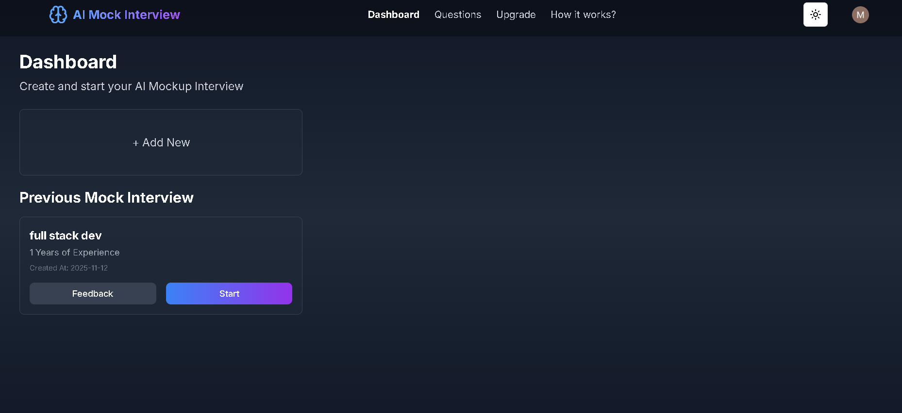
RESULTS

Slide 16
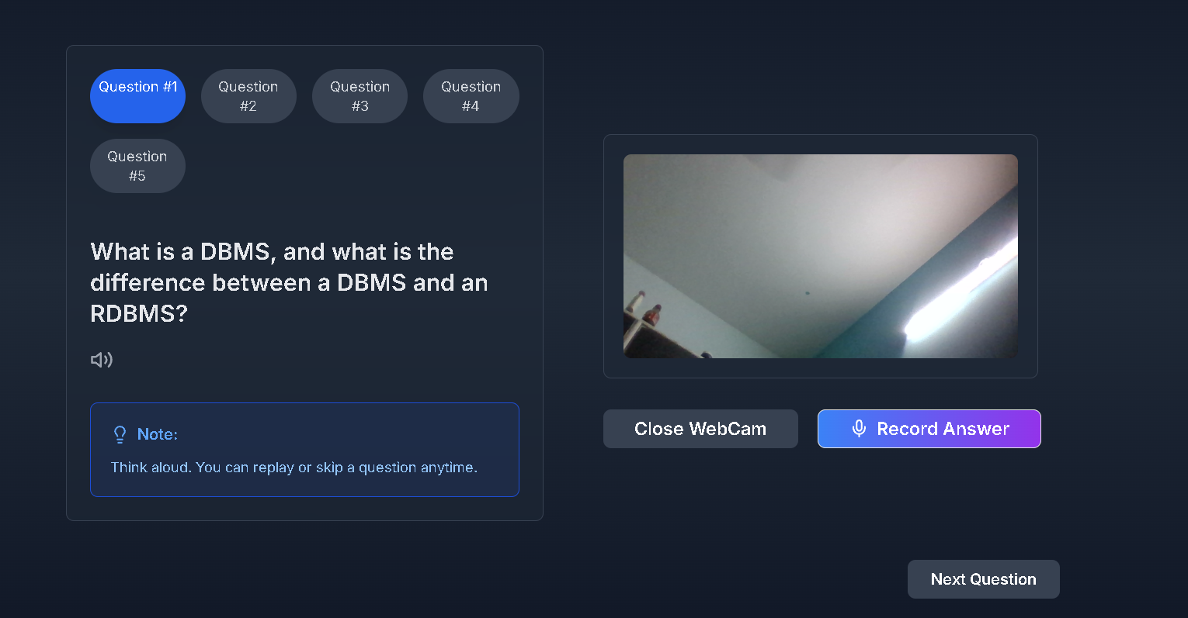
RESULTS

Slide 17
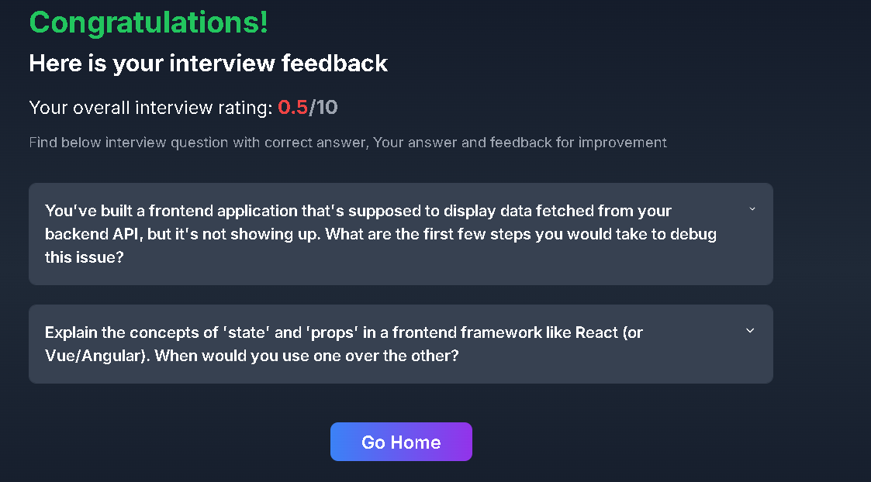
RESULTS

Slide 18
FUTURE ENHANCEMENTS
Voice-first interviews with on-device STT/TTS and timed answers.
Company/role-specific rubrics and question banks.
Multi-lingual interviews (regional languages).
Proctoring features (anti-tab-switch, webcam monitoring).
Advanced analytics (per-competency radar, longitudinal skill growth).
Admin authoring studio for custom prompts and curated PYQ sets.
Mobile app (React Native) with offline progress.

Slide 19
CONCLUSION
The AI mock interview project demonstrates the power of Gemini-driven interview simulations, offering scalable, personalized preparation that includes structured feedback and measurable progress. By leveraging cutting-edge technologies like Next.js for seamless front-end development, Clerk for secure authentication, Drizzle ORM with NeonDB for efficient data management, and Stripe for payment integration, the platform ensures an exceptional user experience. Additionally, the use of Docker for containerization and Vercel for deployment guarantees a robust and scalable solution, capable of handling a large volume of users. With these technologies, AI mock interview is not only production-ready but also highly extensible, making it suitable for a wide range of applications, from academic environments to enterprise-level use cases. The platform is designed to be flexible, allowing easy integration and future enhancements as it grows and evolves to meet the needs of various users.

Slide 20
References
Patil, S. M., Shinde, K. V., Vakare, B. G., & Dunbale, S. S. (2025, Jan.–Feb.).
AI Powered Mock Interview Platform. International Journal of Innovative Research in
Modern Education and Science (IJIRMPS), Vol. 13, No. 1.
Available online: https://www.ijirmps.org/research-paper.php?id=231993 ijirmps.org
AI Based Mock Interview System. (2025, May 9).
International Journal of Research Publication and Reviews (IJRPR).
PDF available: https://ijrpr.com/uploads/V6ISSUE5/IJRPR45237.pdf IJRPR
Thangaraj, D., Selvan, T., Rahul, P. A., & Aswin, S. (2025, Apr.).
AI-Based Mock Interview Platform. International Research Journal of
Modernization in Engineering, Technology and Science (IRJMETS), Vol. 07, Issue 04.
DOI: https://www.doi.org/10.56726/IRJMETS72440 IRJMETS
Chavan, N., Shivpuje, P., Mali, S., & Sayyad, A. (2024, Oct.).
AI-Based Mock Interview System. International Research Journal of
Modernization in Engineering Technology and Science (IRJMETS), Vol. 06, Issue 10.
DOI: https://www.doi.org/10.56726/IRJMETS63116

Slide 21

12

Slide 22

12

